Slide 1
Fraud Detection in Healthcare Claims Using SQL
A Data Analyst Project – SQL
Presented by :- Kunal Warghade
Date:- 05-10-2024

Slide 2
Introduction
Briefly introduce the project scope:
Overview of healthcare claims data.
Importance of fraud detection in healthcare.
Mention the dataset used: outpatient, inpatient, and beneficiary tables.
Tools used: SQL for querying and data analysis.

Slide 3
Objectives
Main Goals
Identify providers with fraudulent claims.
Analyze reimbursement trends for potential anomalies.
Understand patterns in claim denials and chronic condition prevalence.
Provide insights into the healthcare claims process.

Slide 4
Data Overview
Overview of tables used: train inpatient, train outpatient, train beneficiary.
Mention key fields: claim IDs, providers, diagnoses, reimbursement amounts,
and chronic conditions.
3. High-level summary of data size (number of records, providers, beneficiaries).

Slide 5
Methodology and Key Queries
Explain the queries executed to analyze the data.
Focus on queries related to:
Claims count.
Provider analysis.
Chronic conditions.
Fraud detection (with subqueries).
Briefly explain the logic used in complex queries like subquery usage for fraud detection.

Slide 6
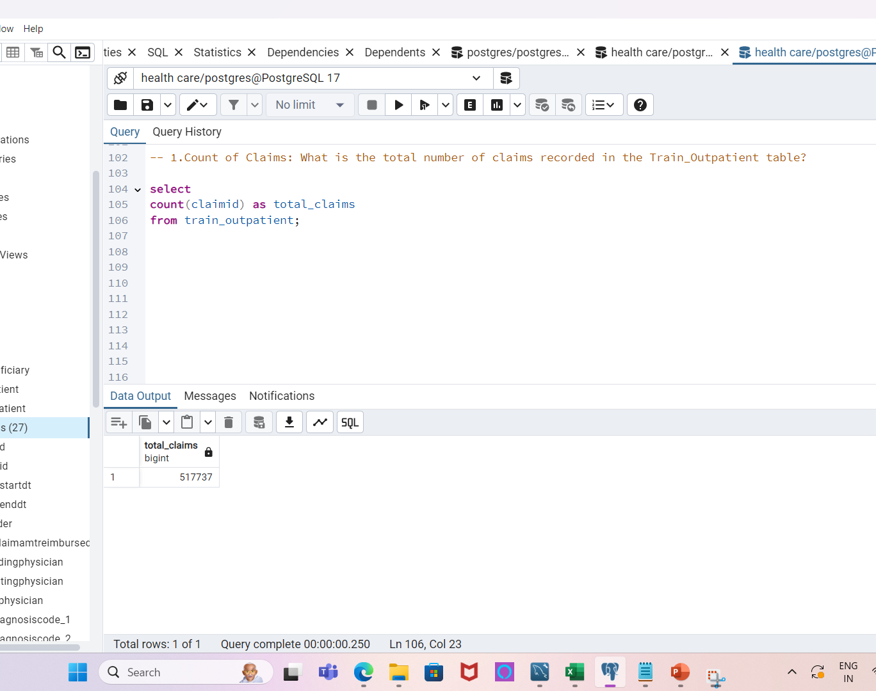
1. What is the total number of claims recorded in the Train Outpatient table?
1. Determines the volume of claims
in the dataset.
2. Helps understand the size of the
outpatient data.
3. Can be useful for measuring overall
healthcare service utilization.

Slide 7
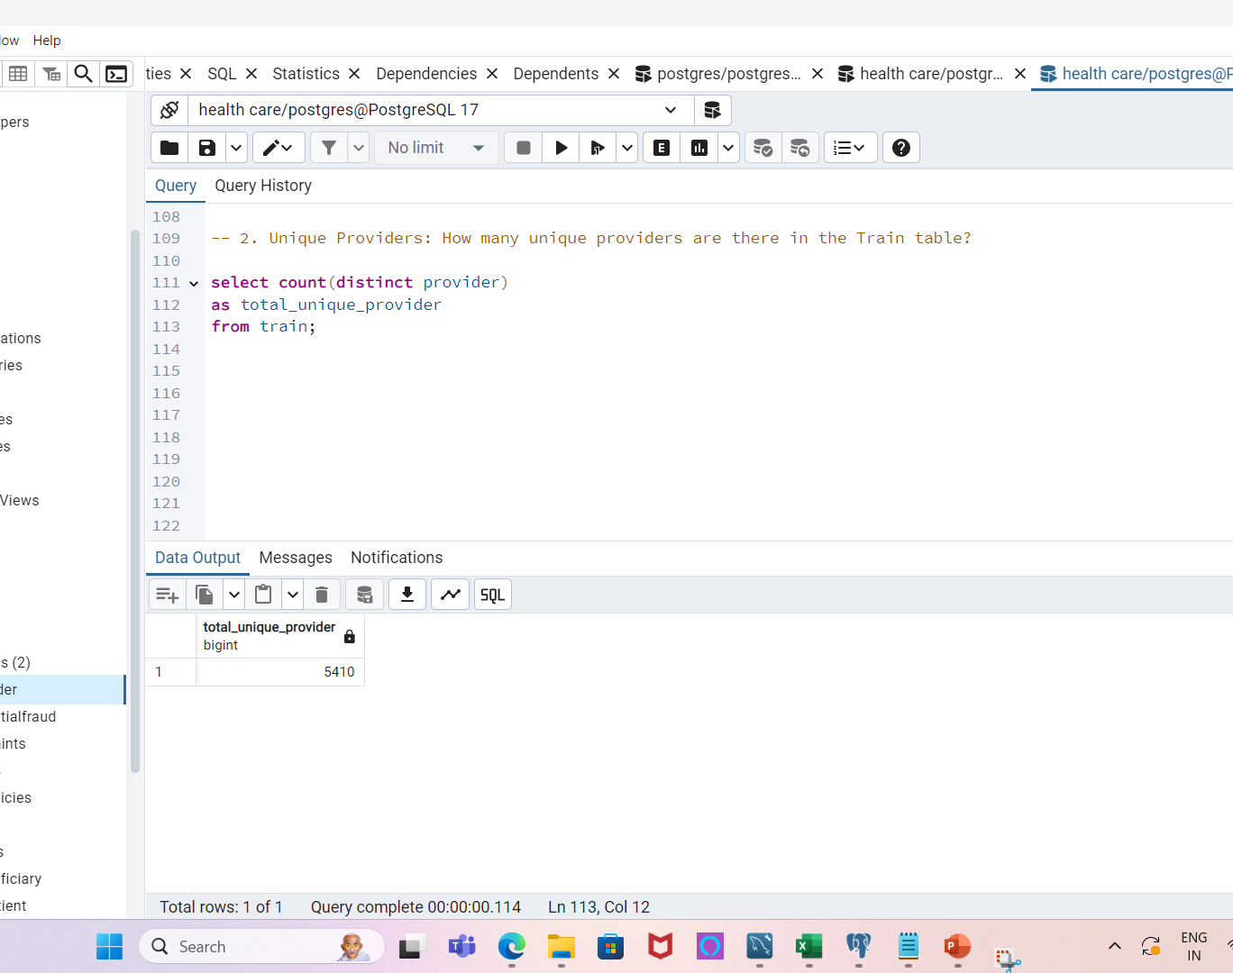
2. How many unique providers are there in the Train table?
1. Shows the number of different
healthcare providers in the dataset.
2. Important for provider-based analysis.
3. Identifies the breadth of providers involved
in claims submission.

Slide 8
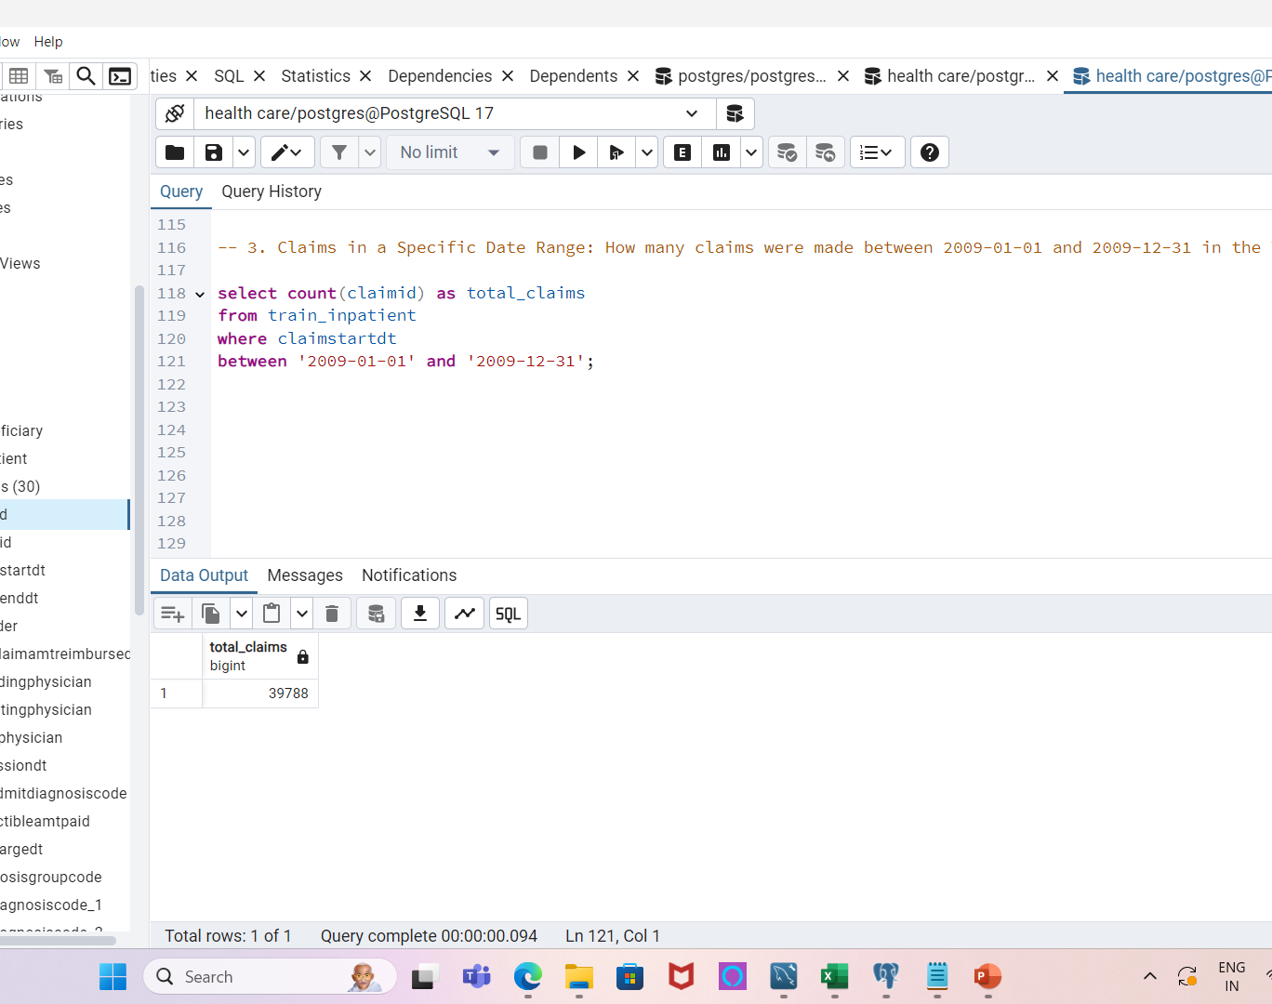
3. How many claims were made between 2020-01-01 and 2020-12-31 in the Train Inpatient table?
1. Focuses on a specific period for
claim analysis.
2. Useful for identifying trends or
unusual claim volumes.
3. Can assist in detecting seasonal
patterns in healthcare claims

Slide 9
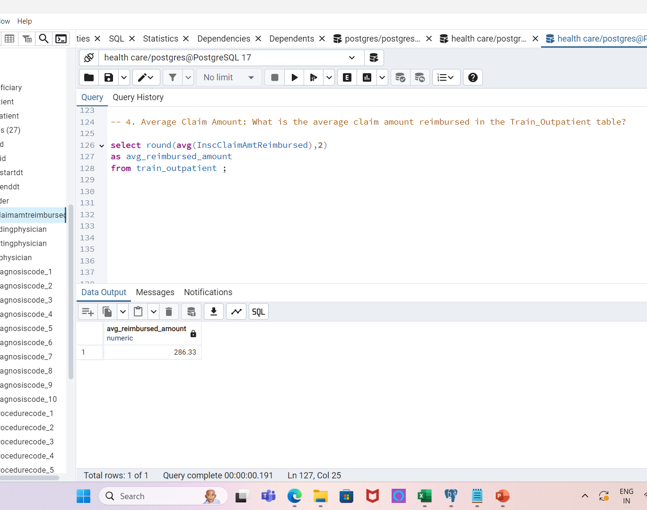
4. What is the average claim amount reimbursed in the Train Outpatient table?
1. Gives insight into the typical reimbursement
amounts.
2. Helpful for financial analysis of claims.
3. Can be used to assess the cost of outpatient
services.

Slide 10
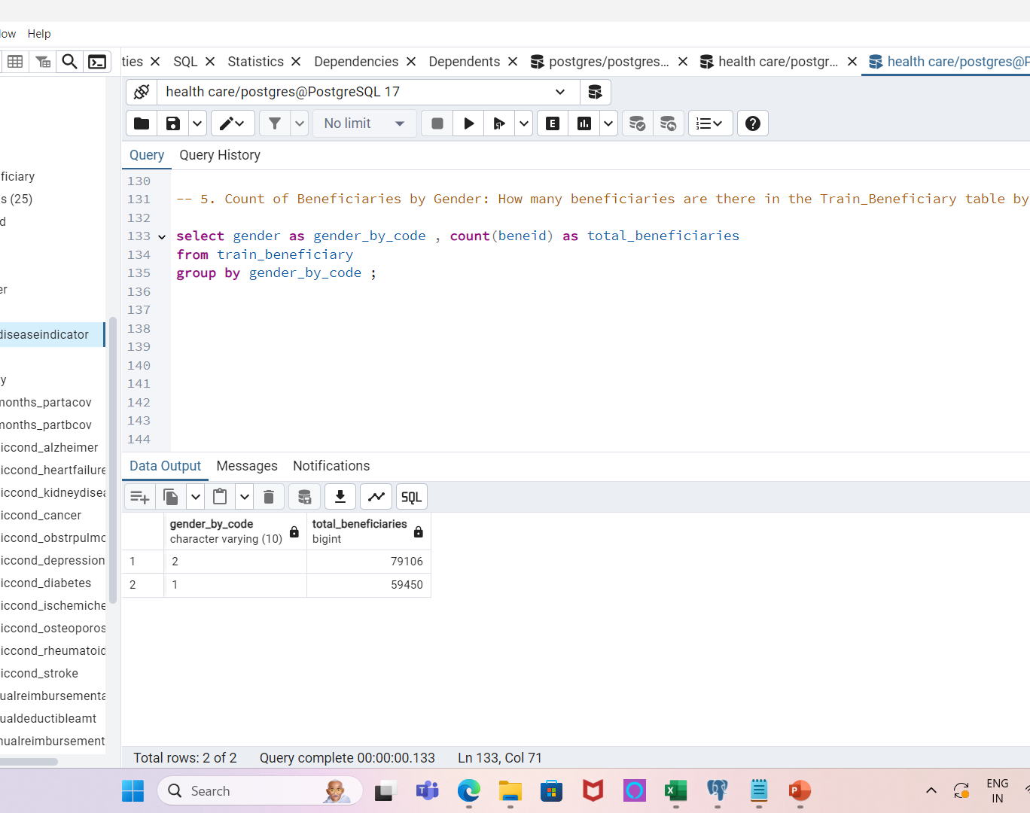
5. How many beneficiaries are there in the Train Beneficiary table by gender?
1. Provides a gender-based breakdown of
beneficiaries.
2. Helps analyze demographics for healthcare
services.
3. Important for assessing gender-based
healthcare trends.

Slide 11
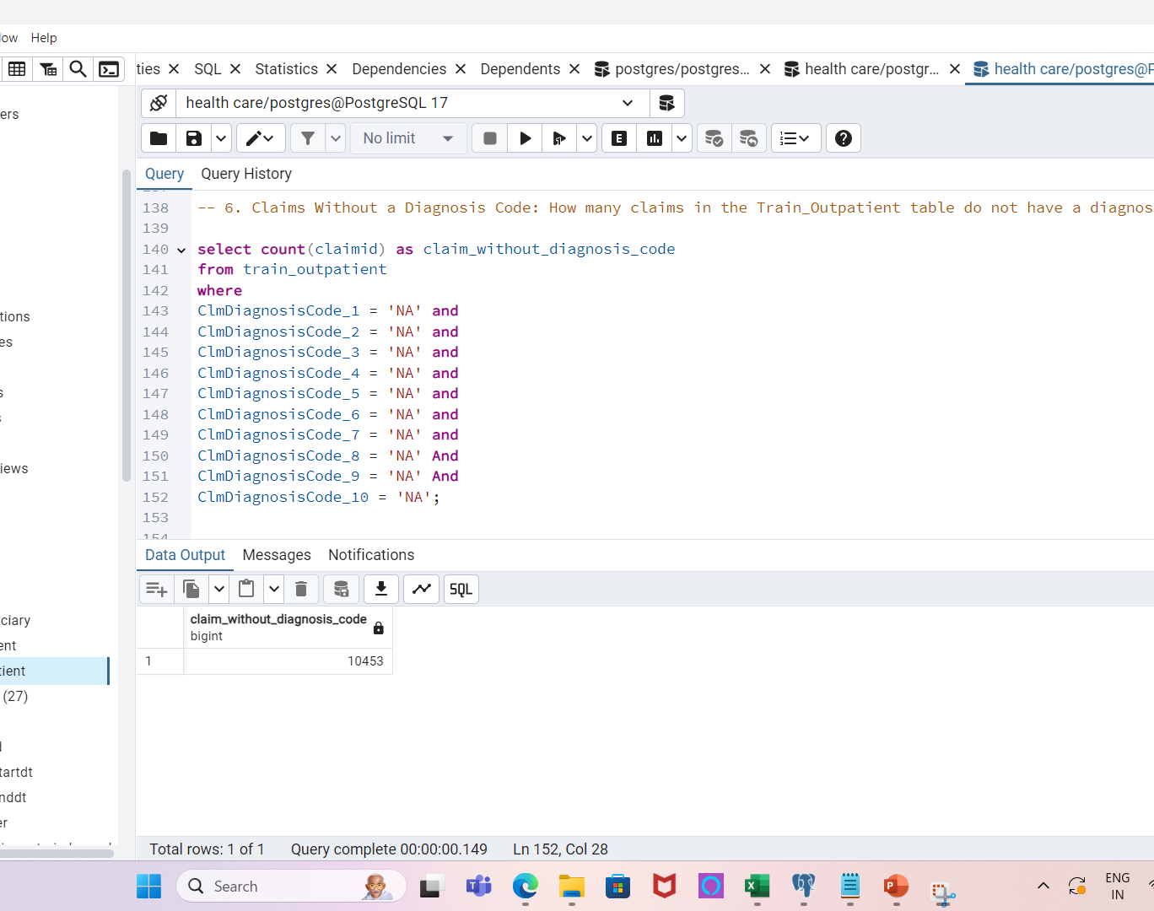
6. How many claims in the Train Outpatient table do not have a diagnosis code?
Detects missing diagnosis codes in claims.
Useful for identifying incomplete or problematic data.
Important for data validation and quality checks.

Slide 12
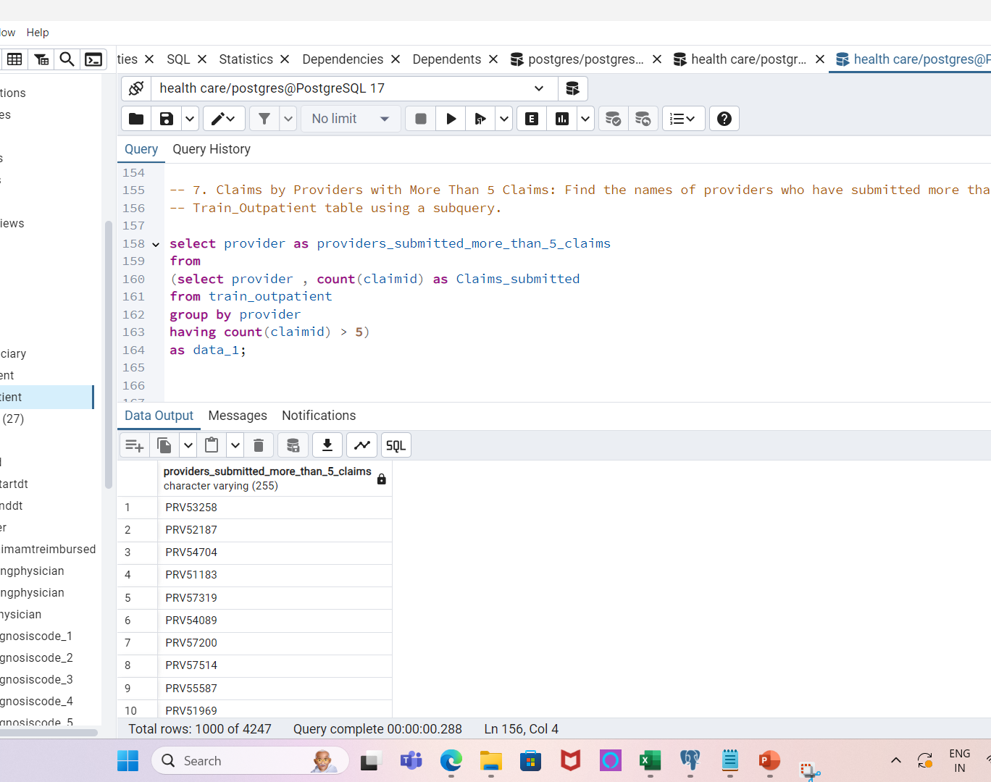
7. Find the names of providers who have submitted more than 5 claims in the Train Outpatient table using a subquery.
Identifies providers with significant claim volumes.
Helps focus on providers who have regular claim submissions.
Can assist in investigating provider behavior.

Slide 13
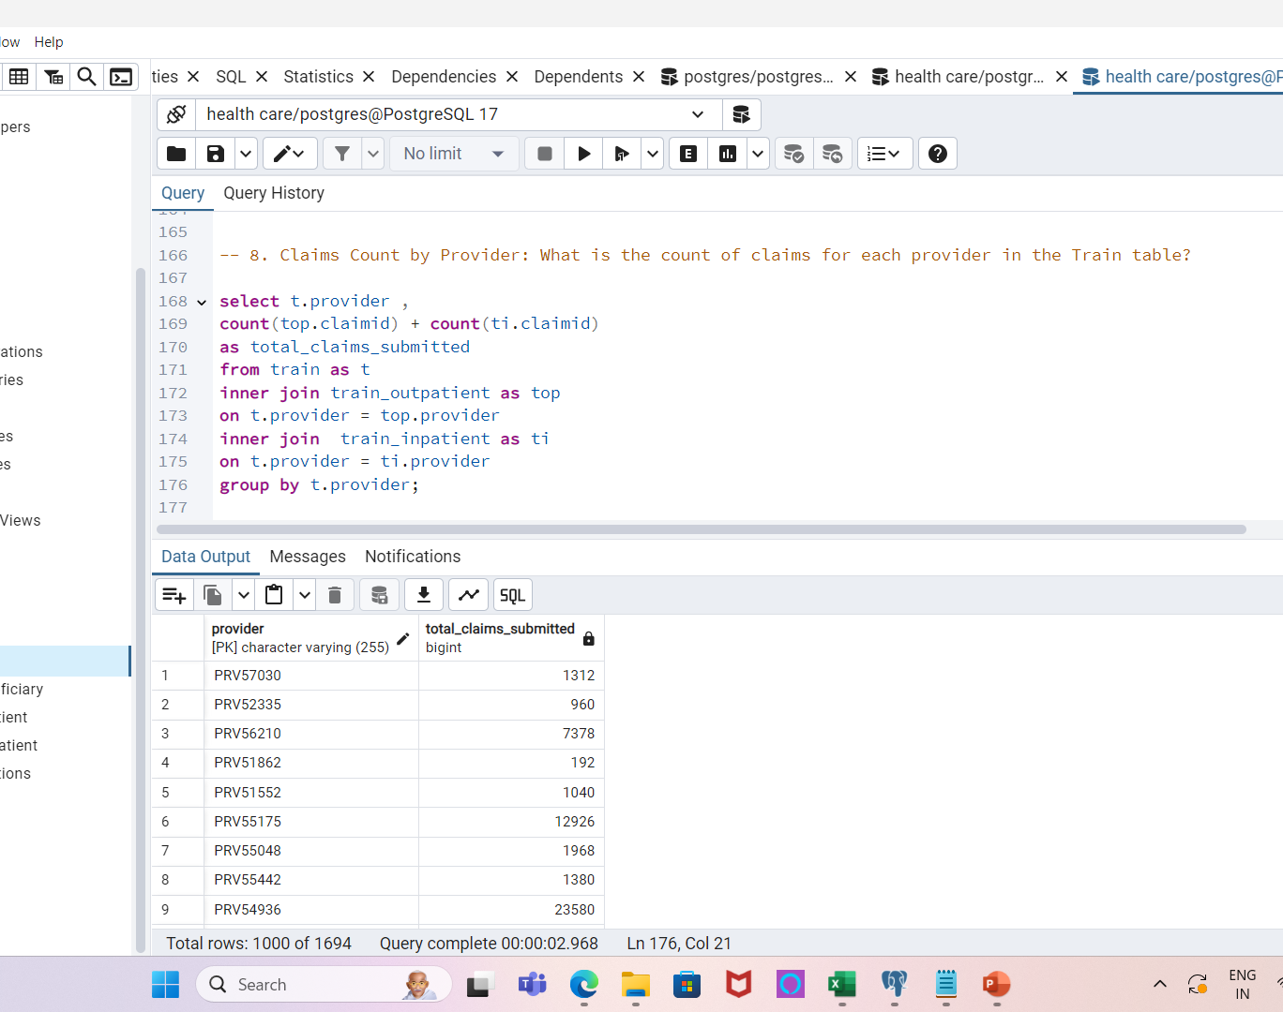
8. What is the count of claims for each provider in the Train table?
Gives a detailed breakdown of claims per provider.
Useful for provider-level analysis and comparisons.
Can highlight providers with higher or lower claim volumes.

Slide 14
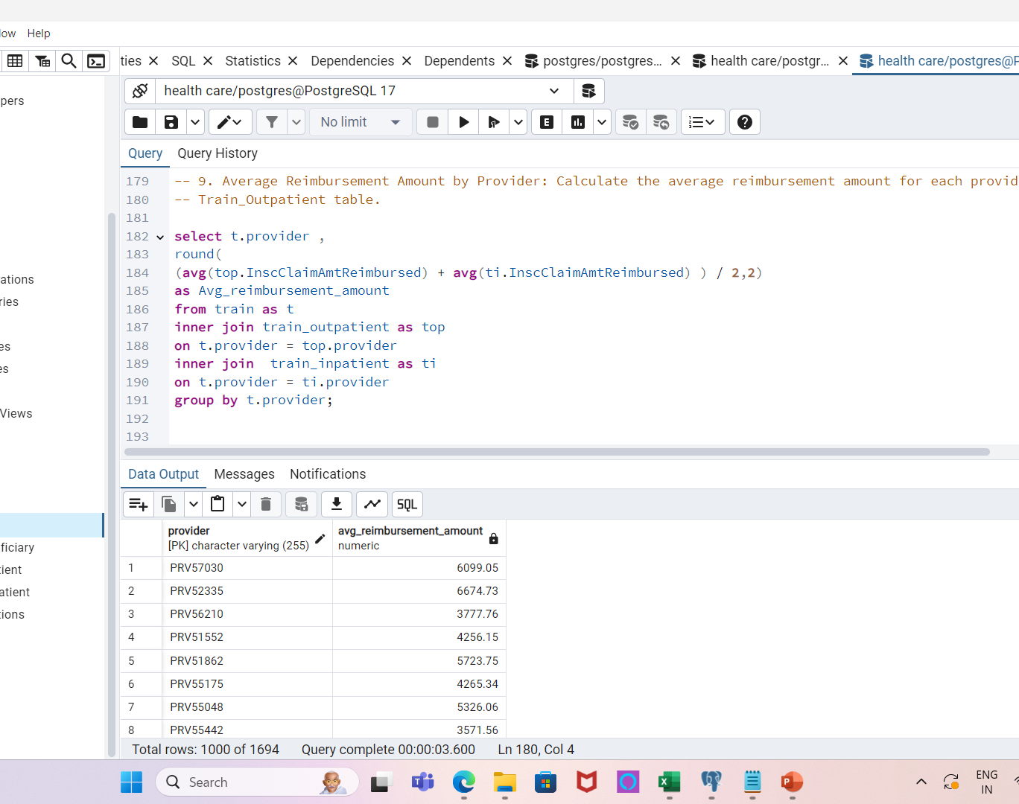
9. Calculate the average reimbursement amount for each provider in the Train Outpatient and Inpatient table.
Provides insight into how much each provider is typically reimbursed.
Useful for financial analysis at the provider level.
Can help identify providers with unusually high or low reimbursement amounts.

Slide 15
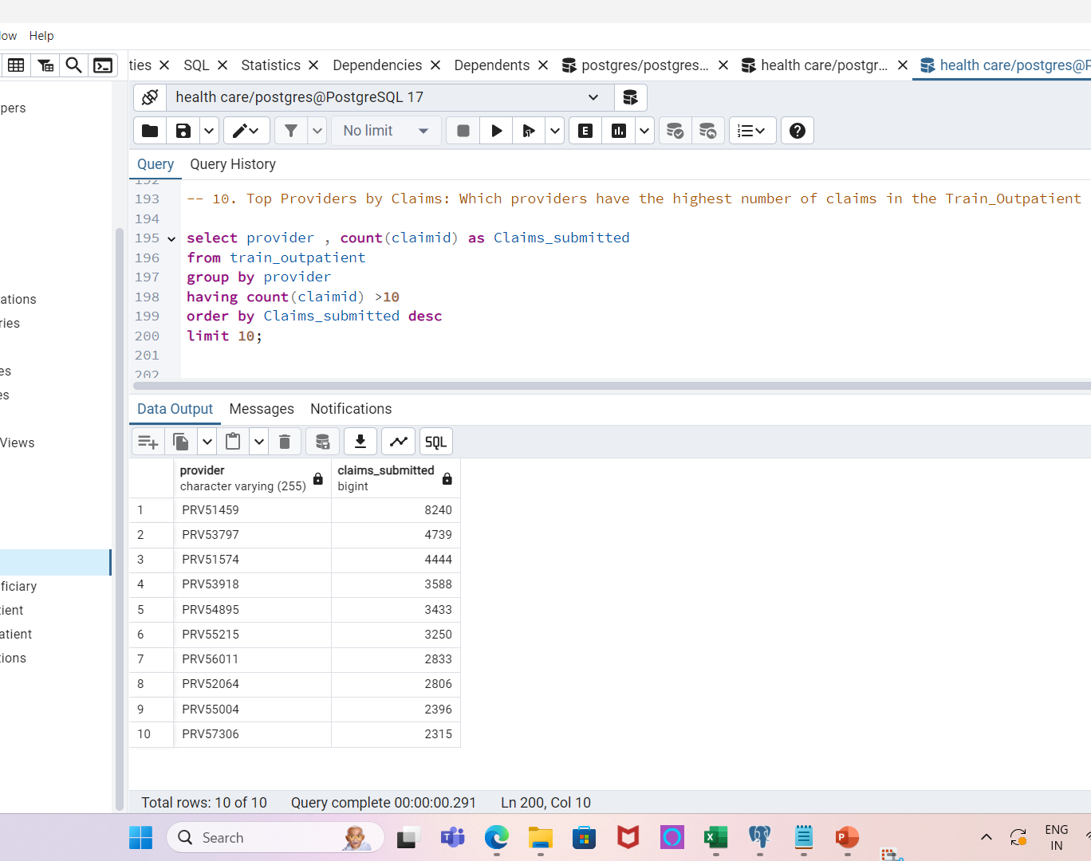
10. Which providers have the highest number of claims in the Train Outpatient table?.
Focuses on providers with the most claims submitted.
Helps to identify major players in the dataset.
Can highlight providers that may require further investigation.

Slide 16
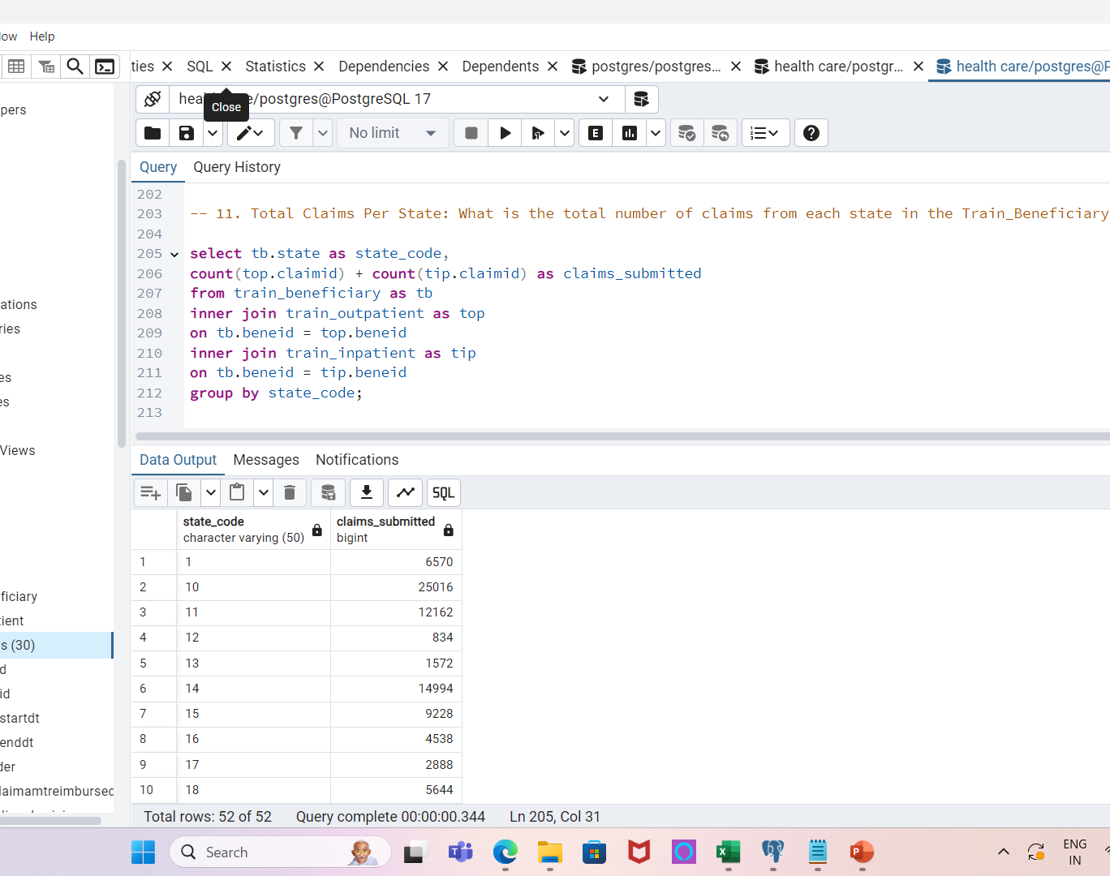
11. What is the total number of claims from each state in the Train Beneficiary table?
Breaks down claims by geographic location.
Useful for regional healthcare analysis.
Can help detect patterns of claims across states.

Slide 17
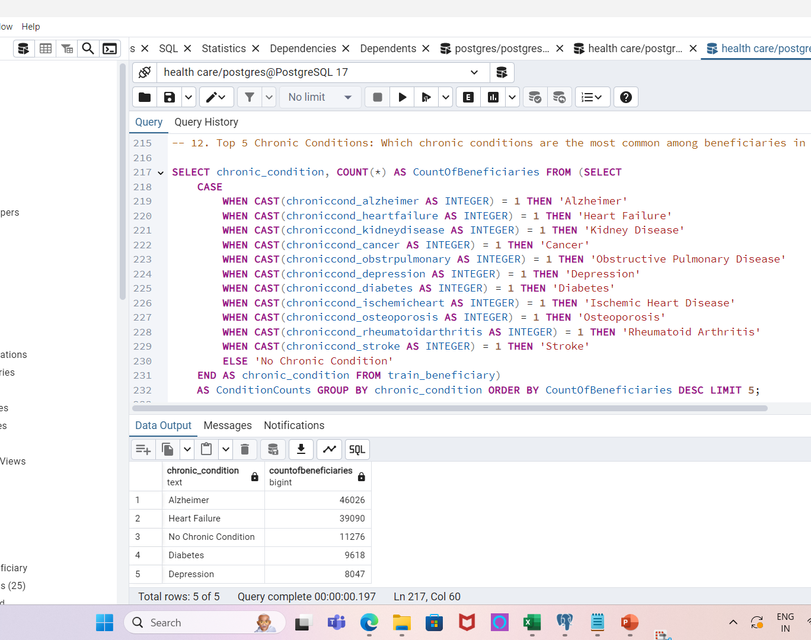
12. Which chronic conditions are the most common among beneficiaries in the Train Beneficiary table?
Highlights the most prevalent chronic conditions.
Useful for healthcare trend analysis and resource allocation.
Can guide prevention and treatment focus areas.

Slide 18
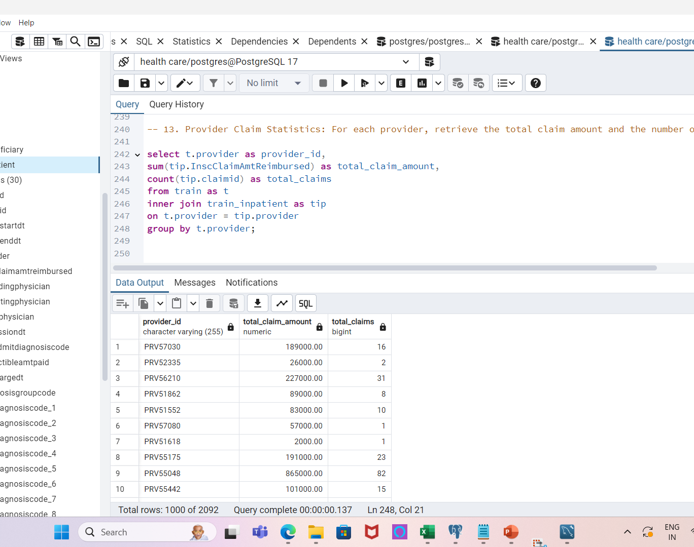
13. For each provider, retrieve the total claim amount and the number of claims in the Train Inpatient table.
Gives a detailed summary of claims per provider.
Useful for detecting potential outliers or fraud.
Helps identify patterns of service utilization.

Slide 19
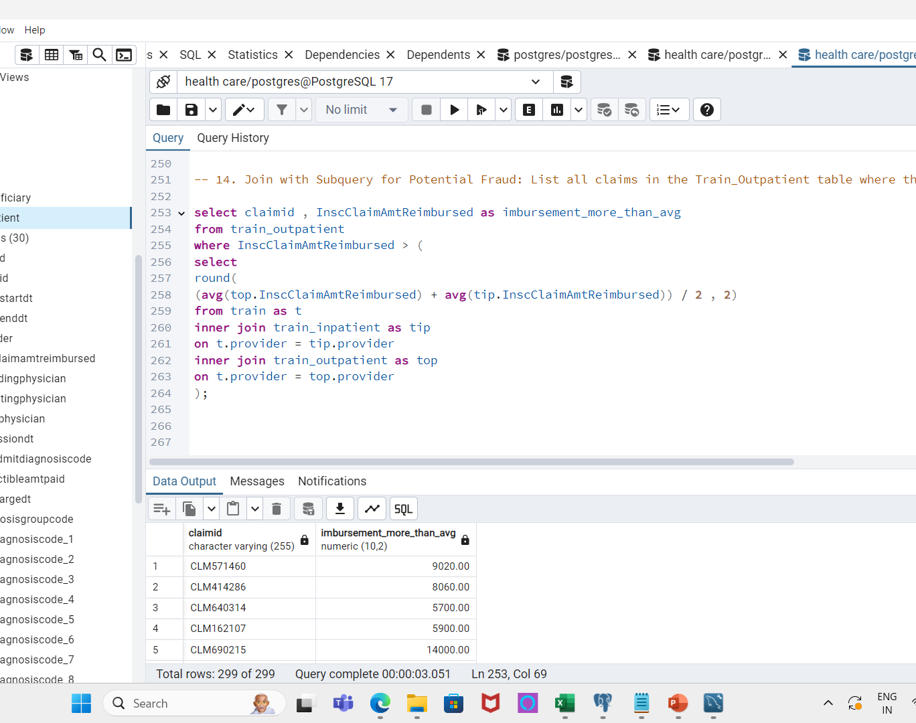
14. List all claims where the reimbursement amount exceeds the average reimbursement amount across all claims.
Helps identify claims with unusually high reimbursement.
Useful for flagging potential fraudulent activity.
Can be the basis for further investigation of outlier claims.

Slide 20
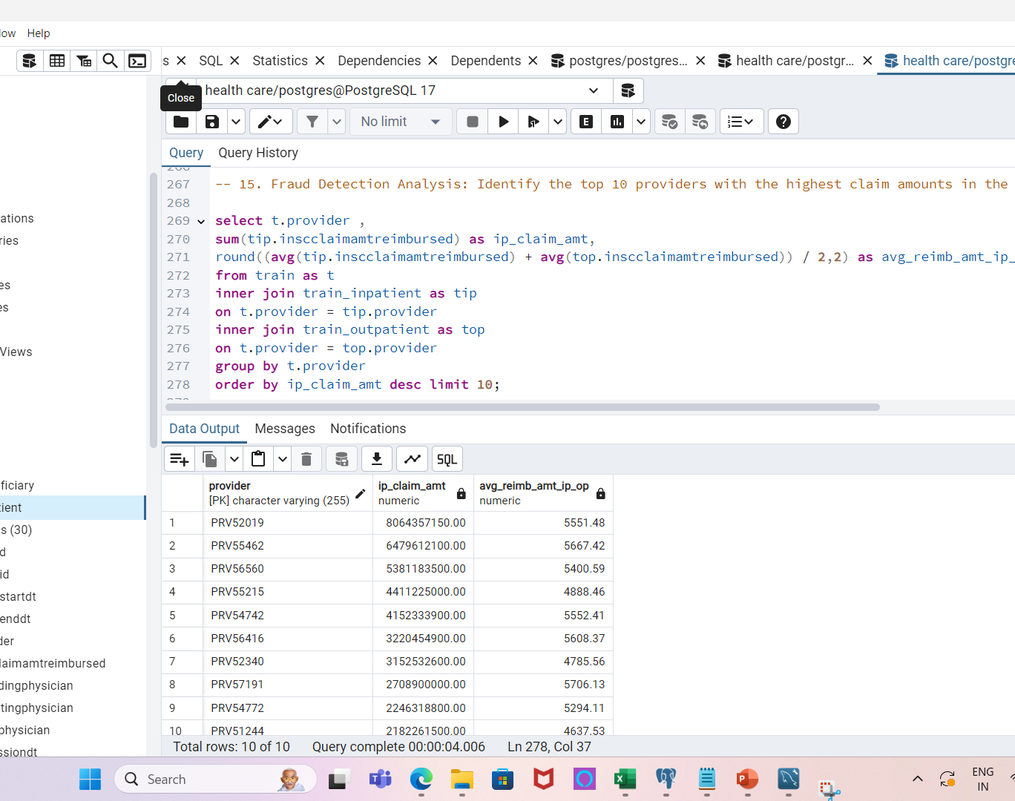
15. Identify the top 10 providers with the highest claim, along with their average reimbursement amount.
Focuses on providers with high claim volumes.
Useful for fraud detection and further scrutiny.
Can help prioritize investigations into high-claim providers.

Slide 21
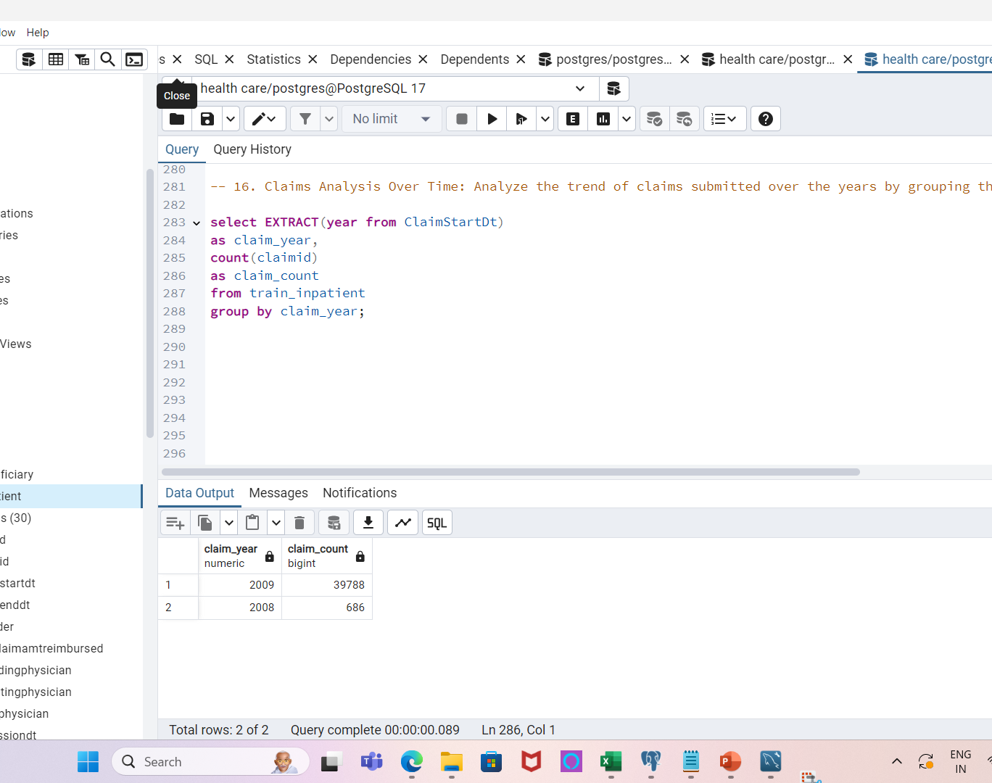
16. Analyze the trend of claims submitted over the years by grouping them by year in the Train Inpatient table
Detects claim submission patterns over time.
Useful for identifying peaks or dips in claim activity.
Helps track changes in service usage.

Slide 22
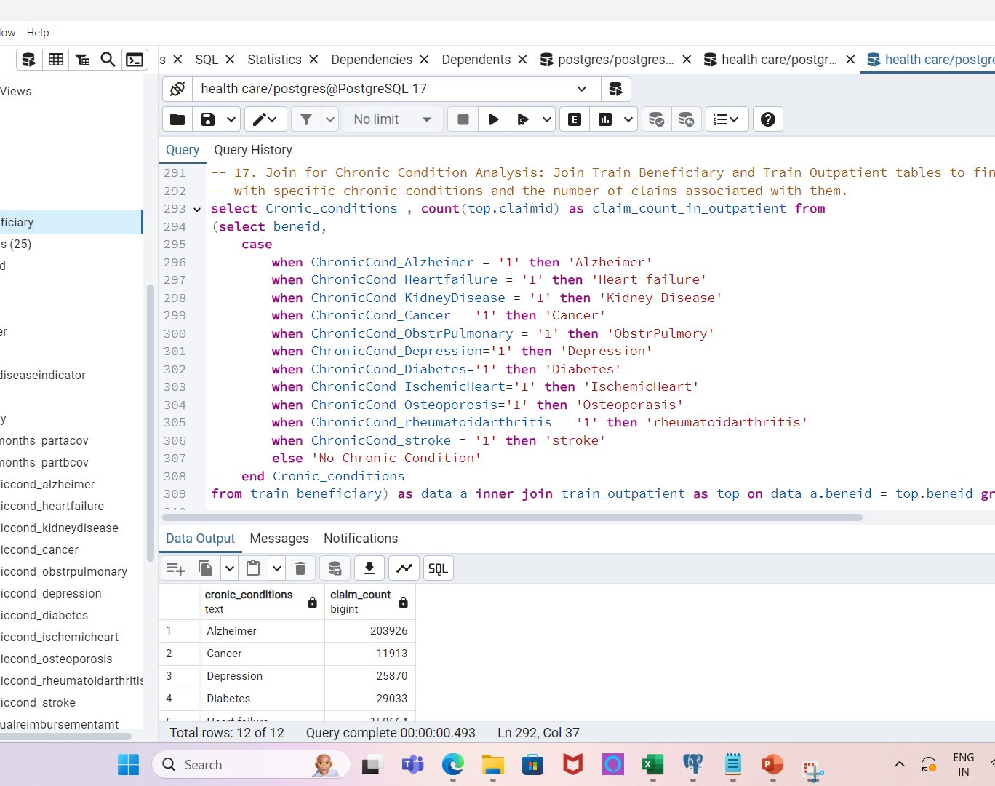
17. Find beneficiaries with specific chronic conditions and the number of claims associated with them.
Combines health condition data with claim data.
Useful for analyzing the healthcare utilization of specific conditions.
Helps understand which conditions generate the most claims.

Slide 23
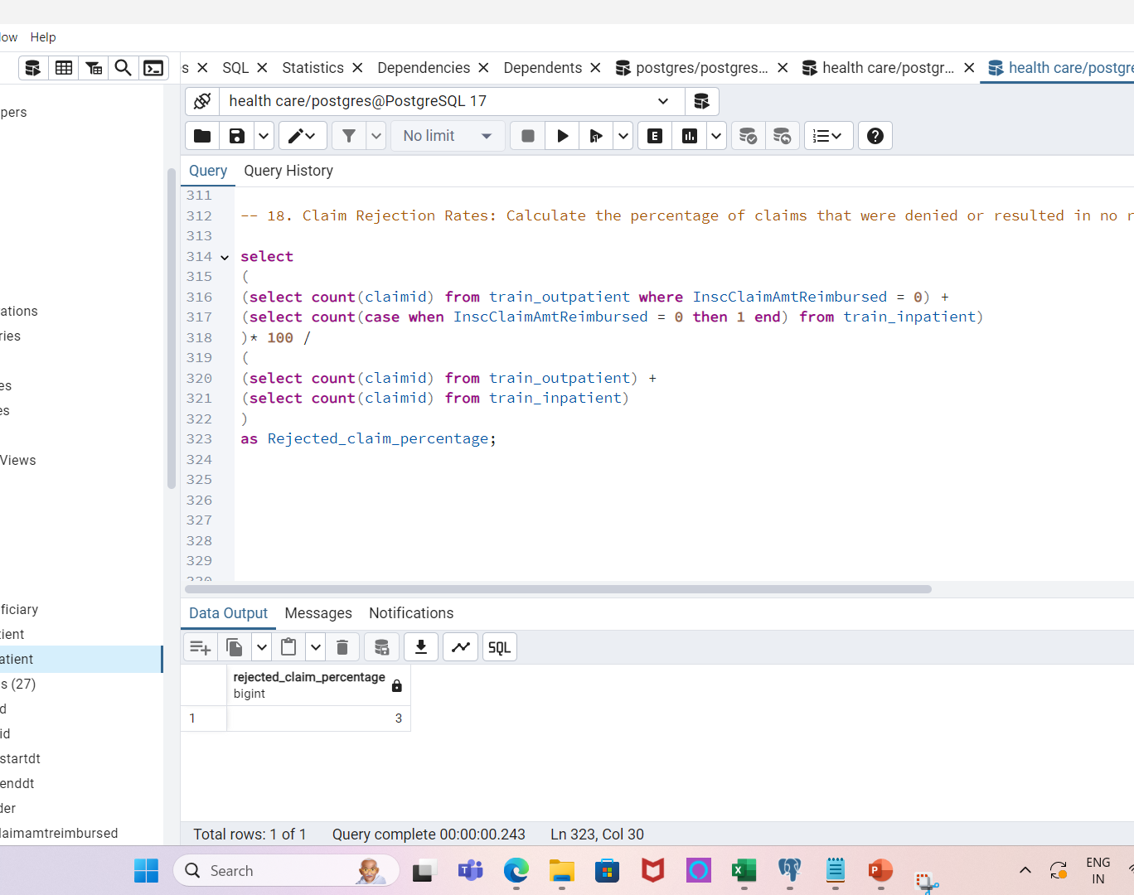
18. Calculate the percentage of claims that were denied or resulted in no reimbursement.
Focuses on the rate of denied claims.
Useful for evaluating claim approval and reimbursement processes.
Can help identify issues with specific providers or claim types.

Slide 24
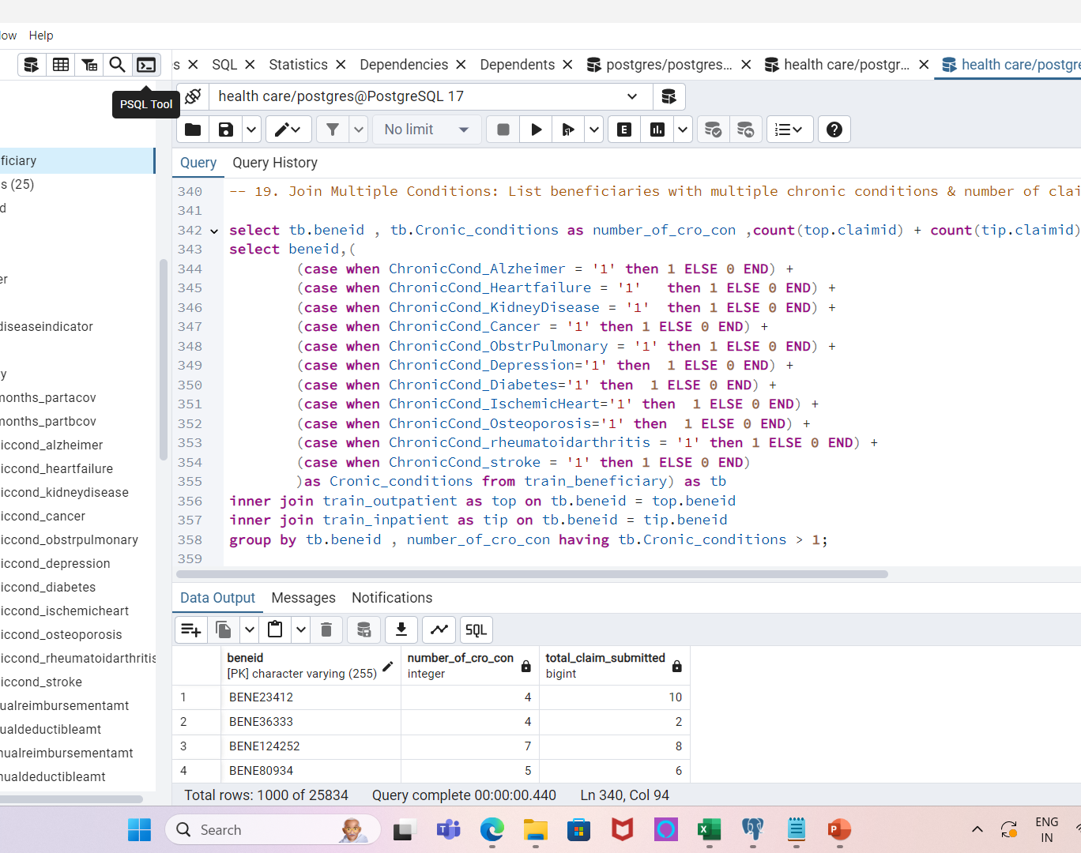
19. List beneficiaries with multiple chronic conditions and the number of claims they have submitted.
Focuses on patients with complex health needs.
Useful for analyzing high-need beneficiaries.
Can guide resource allocation for managing chronic conditions.

Slide 25
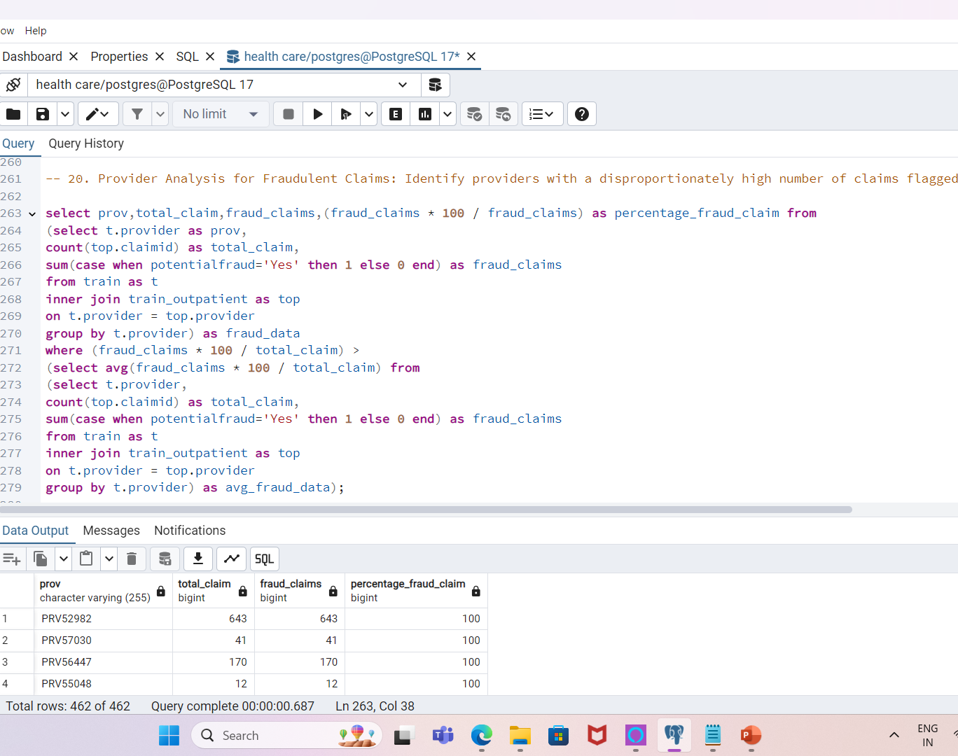
20. Identify providers with a disproportionately high number of claims flagged as potential fraud.
Flags providers with unusual claim behavior.
Useful for targeted fraud detection efforts.
Can help focus on high-risk providers for investigation.

Slide 26
Insights Gathered
Provider Trends:
Providers with a disproportionately high number of claims.
Providers submitting more claims than average.
Chronic Conditions:
Prevalence of chronic conditions in the beneficiary data.
How chronic conditions impact claim submissions.
Reimbursement Patterns:
Outliers in reimbursement amounts that could indicate fraud.
Average vs. flagged reimbursement rates.
Fraud Detection:
Percentage of claims flagged as potential fraud.
Rejection rates of claims and trends in claims with $0 reimbursement.

Slide 27
Challenges Faced
Handling large datasets with multiple tables.
Complex joins and subqueries.
Interpreting trends from raw data.
Ensuring data accuracy and avoiding false positives in fraud detection.

Slide 28
Recommendations
Suggestions for healthcare providers:
Implement regular audits on high-risk claims.
Monitor providers with unusually high reimbursement rates.
For analysts:
Continue enhancing fraud detection models.
Develop machine learning models for future fraud prediction.

Slide 29
Data-Driven Decision Making for Fraud Detection
1. Provider Risk Assessment: By identifying providers with disproportionately high fraud claim rates,
organizations can take preemptive actions to audit and investigate potential fraudulent activities
.
2. Claim Validation Process: Insights from rejected or suspicious claims guide the enhancement of claim
validation systems, improving accuracy and reducing false positives.
3. Resource Allocation: By detecting patterns in fraudulent claims, resources can be allocated more effectively
to high-risk providers and claim types.
4. Compliance and Policy Adjustments: Data-driven insights support regulatory compliance and help adjust
healthcare policies to reduce future fraudulent activities.
5. Cost Reduction: Early detection of fraud reduces financial losses, enabling healthcare providers and
insurers to save costs associated with fraudulent reimbursements.

